Slide 1
Linker script in CW10
MinhNQ2

Slide 2
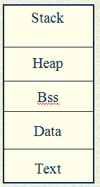
Memory Sections
Text- Instructions that the program runs
Data – Initialized global variables.
Bss – Uninitialized global variables. They are initialized to zeroes.
Heap – Memory returned when calling malloc/new.
Stack – It stores local variables and return addresses.
Each section has different permissions: read/write/execute or a combination of them.

Slide 3
Building a program
C source files
.c
Compiler
.o
Libraries
.a
Linker
Executable file
.o
ASM source files
.s
Assembler

Slide 4
LCF Structure
Linker command files consist of three kinds of segments, which must be in this order:
A memory segment, which begins with the MEMORY{} directive
Optional closure segments, which begin with the FORCE_ACTIVE{}, KEEP_SECTION{}, or REF_INCLUDE{} directives
A sections segment, which begins with the SECTIONS{} directive

Slide 5
Memory Segment
Use the memory segment to divide available memory into segments.
The (RWX) portion consists of ELF-access permission flags: R = read, W = write, or X= execute.
ORIGIN specifies the start address of the memory segment, either an actual memory address or, via the AFTER keyword, the name of the preceding segment.
LENGTH specifies the size of the memory segment. The value 0 means unlimited length.

Slide 6
Closure Segments
Closure segments let you make symbols immune from deadstripping.
FORCE_ACTIVE - Use this directive to make the linker include a symbol that it otherwise would not include.
KEEP_SECTION - Use this directive to keep a section in the link, particularly a user-defined section.
REF_INCLUDE - Use this directive to keep a section in the link, provided that there is a reference to the file that contains the section. This is a useful way to include version numbers.

Slide 7
Sections Segment
Use the sections segment to define the contents of memory sections, and to define any global symbols that you want to use in your output file.
Format
SECTIONS {
sectionName : [AT (loadAddress)]
{
Contents
} > segmentName
}
section_spec

Slide 8
Sections Segment
sectionName: Name for the output section
AT (loadAddress): Optional specify for the load address of the section. The default value is the relocation address.
Contents: Statements that assign a value to a symbol or specify section placement, including input sections.
segmentName: Predefined memory-segment destination for the contents of the section. The two variants are:
> segmentName: puts section contents at the beginning of memory segment segmentName.
>> segmentName: appends section contents to the end of memory segment segmentName

Slide 9
LCF syntax
Variables, Expressions, and Integrals
Arithmetic, Comment Operators
Alignment
Specifying Files and Functions
Stack and Heap
ROM-RAM Copying

Slide 10
Variables, Expressions, and Integrals
All symbol names must start with the underscore character (_). The other characters can be letters, digits, or underscores.
_symbolicname = some_expression;
There are 2 types of expression
Absolute expression — the symbol contains the value that it will have in the output file.
Relocatable expression — the value expression is a fixed offset from the base of a section
LCF syntax for expressions is very similar to the syntax of the C programming language
_decimal_number = 123245;
_hex_number = 0x999999FF;

Slide 11
Arithmetic Operators
Precedence | Operators
1 | - ˜ !
2 | * / %
3 | + -
4 | >> <<
5 | == != > < <= >=
6 | &
7 | |
8 | &&
9 | ||

Slide 12
Comment Operators
Use the sharp character “#” for one line comment
#this is one line comment
Use slash and asterisk “/*” for multi-line comment
/* this is
multiline comment */
Use double slash “//” for partial-line comment
//this is partial-line comment

Slide 13
Specifying Files and Functions
Specifying Files: Defining the contents of a sections segment includes specifying the source file of each section.
Method 1: listing the files
Method 2: use the asterisk ( * ) wild-card character, which represents the names of every file in your project.
Specifying Files: For precise control over function placement within a section, use the OBJECT keyword.
SECTIONS {
.program_section :
{
OBJECT (beta, main.c)
OBJECT (alpha, main.c)
* (.text)
} > ROOT

Slide 14
Stack and Heap
Reserving space for the stack and heap requires some arithmetic operations to set the symbol values used at runtime.
Stack Setup Operations
_stack_address = __END_BSS;
_stack_address = _stack_address & ~7; /*align top of stack by 8 */
__SP_INIT = _stack_address + 0x4000; /*set stack to 16KB*/
Heap Setup Operations
___heap_addr = __SP_INIT; /* heap grows opposite stack */
___heap_size = 0x50000; /* heap size set to 500KB */

Slide 15
ROM-RAM Copying
It is common that data or code of a program residing in ROM gets copied into RAM at runtime. To indicate such data or code, use the LCF to assign it two addresses:
The memory segment specifies the intended location in RAM
The sections segment specifies the resident location in ROM, via its AT (address) parameter
For program execution to copy the section from ROM to RAM, a copy table must supply the information that the program needs at runtime. This copy table, which the symbol __S_romp identifies, contains a sequence of three word values per entry:
ROM start address
RAM start address
size

Slide 16
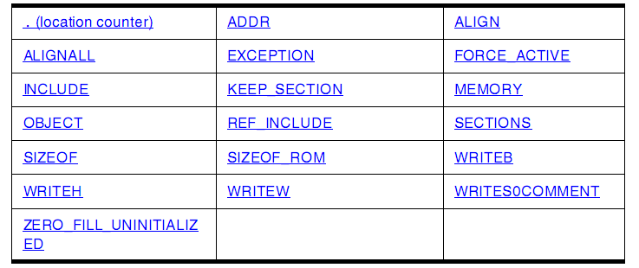
Commands, Directives, and Keywords

Slide 17
Commands, Directives, and Keywords
. (location counter): Denotes the current output location
.data :
{
*.(data)
*.(bss)
*.(COMMON)
__start = .;
. = __start + 0x10000;
__end = .;
} > DATA
ADDR: Returns the address of the named section or memory segment
ADDR (sectionName | segmentName)
sectionName: Identifier for a file section.
segmentName: Identifier for a memory segment

Slide 18
Commands, Directives, and Keywords
ALIGN: Returns the location-counter value, aligned on a specified boundary.
ALIGN(alignValue)
alignValue: Alignment-boundary specifier; must be a power of two.
ALIGNALL: Forces minimum alignment of all objects in the current segment to the specified value.
ALIGNALL(alignValue);
alignValue: Alignment-value specifier; must be a power of two.

Slide 19
Commands, Directives, and Keywords
FORCE_ACTIVE: Starts an optional LCF closure segment that specifies symbols the linker should not deadstrip.
FORCE_ACTIVE{ symbol[, symbol] }
symbol: Any defined symbol.
INCLUDE: Includes a specified binary file in the output file.
INCLUDE filename
filename: Name of a binary file. The path of the binary file needs to be specified as linker command line argument.
KEEP_SECTION: Starts an optional LCF closure segment that specifies sections the linker should not deadstrip.
KEEP_SECTION{ sectionType[, sectionType] }
sectionType: Identifier for any user-defined or predefined section.

Slide 20
Commands, Directives, and Keywords
MEMORY: Starts the LCF memory segment, which defines segments of target memory.
MEMORY { memory_spec[, memory_spec] }
memory_spec:
segmentName (accessFlags) : ORIGIN = address,
LENGTH = length [> fileName]
segmentName: Name for a new segment of target memory.
accessFlags: ELF-access permission flags — R = read, W = write, or X = execute.
address: A memory address or an AFTER command
Length: Size of the new memory segment
fileName: Optional, binary-file destination

Slide 21
Commands, Directives, and Keywords
SIZEOF: Returns the size (in bytes) of the specified segment or section.
SIZEOF(segmentName | sectionName)
segmentName: Name of a segment
SIZEOF_ROM: Returns the size (in bytes) of the specified segment or section.
SIZEOF(segmentName | sectionName)
segmentName: Name of a ROM segment
WRITEB, WRITEH, WRITEW: Inserts a byte of data at the current address of a section.
WRITEx (expression);
expression: Any expression that returns a value in range

Slide 22
Commands, Directives, and Keywords
WRITES0COMMENT: Inserts an S0 comment record into an S-record file.
WRITES0COMMENT "comment"
comment: Comment text
ZERO_FILL_UNINITIALIZED: Forces the linker to put zeroed data into the binary file for uninitialized variables. This directive must lie between the directives MEMORY and SECTIONS; placing it anywhere else would be a syntax error.
ZERO_FILL_UNINITIALIZED

Slide 23
Defining Sections in Source Code
Format
#pragma define_section sname ".istr" [.ustr] [.rostr] [addrmode] [accmode]
#pragma section sname begin
/* Code */
#pragma section sname end
__declspec(section " sname ") <prototype>;
Parameters
sname: Identifier for source references to this user-defined section.
istr: Section-name string for initialized data assigned to this section
ustr: Optional: ELF section name for uninitialized data assigned to this section.
rostr: Optional: ELF section name for read only data assigned to this section.
addrmode: Optional: optional parameter indicates how the linker addresses the section.
acc: access permission in this section

Slide 24

Thanks for your attention!

